Slide 1
Value Driven Delivery through Agile
Domain II

Slide 2





Context
Agile Practices aim to maximise
Business value creation acknowledging the
cloud of uncertainty and
Navigating through it.
Delivery
Risk
Waste
Creating Business Value

Slide 3
Value-Driven Delivery : Core to Agile
Agile Manifesto values:
“Working Software over comprehensive documentation”
Agile Manifesto principles:
“Deliver Working software frequently”
“Working software is the primary measure of progress”

Slide 4


Value Delivery : Context
Stakeholder Need
Deliver valuable result
Prioritise
Feedback
Feedback
Review
Produce High Value Increments
Feedback early
And Often
Value Delivered
Notes:
Definition : (Reference ECO)
Deliver valuable results by producing high-value increments for review, early and often, based on stakeholder priorities. Have the stakeholders provide feedback on these increments, and use this feedback to prioritize and improve future increments.

Slide 5
Value Driven Delivery - SubDomains
Define positive value
Avoid Potential Downsides
Prioritisation
Incremental Development
Source :ACP -ECO

Slide 6
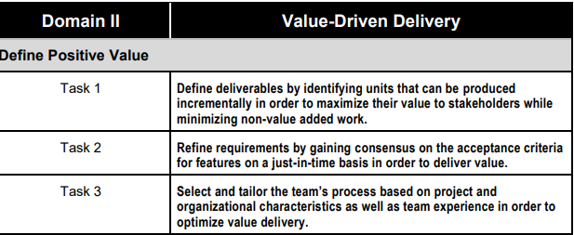
Value Driven Delivery- Tasks

Slide 7
Define Positive Value
Business Growth
Compliance to Regulatory Norm
Compliance to Safety Norm
Improvement in life
Cost Reduction etc..

Slide 8
Define Positive Value (Ref TASK 1)
Identify Units that can be produced incrementally
Enhance value added work
Reduce non value added work
Refine requirements by gaining consensus on the acceptance criteria for features on just-in-time basis
Select and tailor team’s process based on project and Organisational characteristics as well as Team’s experience in order to maximise Value delivery

Slide 9
Agile Practice to Define Positive Value
High Uncertainty Projects with high rate of changes and risk, derive value following Agile Practice
But how…
Gather requirement Iteratively and deliver Incrementally
The applied approaches use
Very short feedback loop
Frequent adaptation of process
Reprioritisation
Regularly Updated Plan
Frequent Delivery

Slide 10
Value- Driven Delivery
Note : The tools & techniques and Knowledge & Skills are not exhaustive .
Tasks | Question | T&T | K&S
Task 1 | How to identify units that can be incrementally developed to maximise on value delivery to Stakeholders and minimise Non Value added work. | Product Roadmap Backlog Release plan | Adaptive Planning
Task 2 | How should refinement of requirements be carried out ? How to develop acceptance criteria for features on just-in-time basis in order to deliver value | Backlog Refinement Spike | Collaboration Backlog Refinement Meeting
Task 3 | How to select and tailor team’s process based on project and organisational characteristics as well as team experience in order to optimise delivery. | Agile Suitability Filter

Slide 11
Terms
Product Roadmap
Spike
Impact Mapping
Backlog Refinement
Agile Suitability Filter

Slide 12
Product Roadmap
This is crafted product vision given by Sponsor and stakeholders
It is further elaborated progressively to make requirement explicitly defined the backlog .

Slide 13
Spikes
A spike is quick deep dive into the problem.
Spike is an investment product owner makes to figure out what needs to be build and how the team is going to build it- in advance of actually building it. The product owner allocates a little bit of team’s capacity now ,ahead of when the story needs to be delivered, so that when the story comes in to sprint, the team knows what to do.
Special type of user story that is use to gain the knowledge (and not the actual feature relevant to customer) to mitigate risk early.
Spike is used for activities such as research, design,investigation,exploration and prototyping
A spike has maximum timebox as the sprint it is contained in it.
Typically Spike is used for activities such as research, design, investigation, exploration and prototyping
Notes:
When to use Spike:
Sometime the team is unsure

Slide 14
How to enter a Spike
Spike stories are part of backlog.
Example Format of Spike story
“In Order to <achieve some goal> < a system or persona > need to <some action>”
Example: In order to estimate the “User screen with payment capabilities” story, the tech lead and BA need to research on payment gateway software API and have some conversations with the PO.

Slide 15
Agile Suitability Filter
Developed by Dynamic System Development method (DSDM) in 1994.
Crystal recommends that smaller less critical project be undertaken with lighter controls and Simpler approaches .Large mission critical projects were recommended to use more rigor and validation.
Boehm and Turner adopted some of the elements from DSDM and Crystal to develop popular assessment model to help determine if project should be undertaken with agile or more traditional approach.

Slide 16
Agile Suitability Filter :Overview of the model
Organisation and Project attributes are assessed under three main categories
Culture:
Is there supportive environment with buy-in for the approach and trust in team?
Team:
Is the team of a suitable size to be successful in adopting agile?
Do its member have the necessary experience and access to business representatives to be successful?
Project:
Are there high rates of change? Is incremental delivery possible? How Critical is the project?

Slide 17
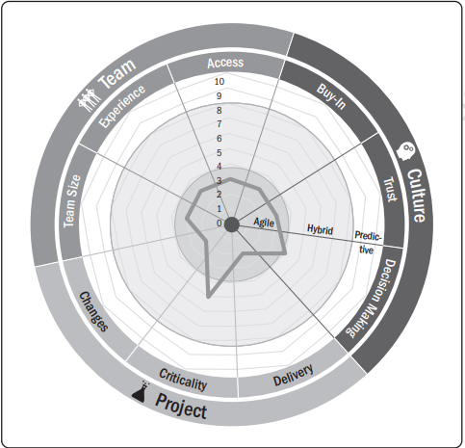
Agile Suitability Filter : Example
Answer to the questionnaire developed by Boehm and Turner’s model under each categories , plotted on a radar chart.
Results around centre suggest agile approach and as we move outside it moves from Agile to Hybrid to Predictive.
Source :PMI ACP

Slide 18
Value Driven Delivery
Define positive value
Avoid Potential Downsides
Prioritisation
Incremental Development
Source :ACP -ECO

Slide 19
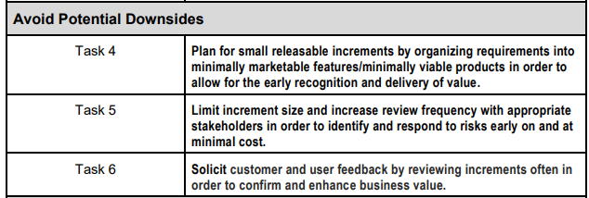
Value Driven Delivery – Sub Domain II

Slide 20
Avoid Potential Downsides
Note : The tools & techniques and Knowledge & Skills are not exhaustive .
Tasks | Question | T&T | K&S
Task 4 | How to plan work for early recognition of work reducing the risk? | MVP/MMF | Customer Values prioritisation Requirement Review
Task 5 | How to identify and respond to risk early and at minimal cost? | Refer Risk Management Domain
Task 6 | How to confirm and enhance business value engaging stakeholders.

Slide 21
Customer ,Stakeholder , User
Customer :
The customers of your organization are those whose needs you’re trying to satisfy through building or updating the product.
They give your organization money in exchange for some product or service.
Users
They ae the one who are supposed to use the system
Stakeholders
Customer, Users and anybody who is impacted or can impact the project are Stakeholders

Slide 22
Customer ,Stakeholder , User
 | Customer | Stakeholder | User | Remarks
Who are they | Customer finance the project and ultimate owner of the product | A stakeholder can positively or negatively impact the project | Users donot participate in the project but ultimately will use the product | Customers and users are also stakeholders
Project Decision Impact | Right Thing to build | Consideration in form of constrains, risks and assumptions and dependencies in to what you build | Right Design to develop | Though Users have no say on product development , however , system usability and effectiveness depends on taking real users in consideration

Slide 23
Customer ,Stakeholder , User
 | Customer | Stakeholder | User | Remarks
Requirement Gathering | Requirement by customer need due consideration , hence should be collected as clearly as possible in the Product roadmap. | The requirement by stakeholders other than customer need to be vetted in terms of alignment with customer’s project objective. | No participation in the project
Approval | Prioritisation of features Product Acceptance criteria | Product verification and validation

Slide 24
Value Driven Delivery
Define positive value
Avoid Potential Downsides
Prioritisation
Incremental Development
Source :ACP -ECO

Slide 25
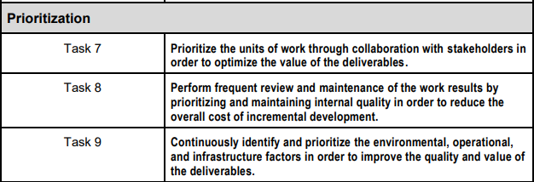
Value Driven Delivery – Sub Domain II

Slide 26
Prioritisation
Note : The tools & techniques and Knowledge & Skills are not exhaustive .
Tasks | Question | T&T | K&S
Task 7 | How to apply prioritisation to optimise the value of deliverables | MoSCoW Kano Model Relative Prioritisation/Ranking Customer Valued Prioritisation | Collaboration
Task 8 | How to prioritise and maintain internal quality in order to reduce the overall cost of incremental development. | Frequent verification and Validation Definition of Done Continuous Integration
Task 9 | How to manage quality and value of deliverables affected by environmental, operational and Infrastructure factor. | Frequent verification and Validation Compliance

Slide 27
Value Driven Delivery
Define positive value
Avoid Potential Downsides
Prioritisation
Incremental Development
Source :ACP -ECO

Slide 28
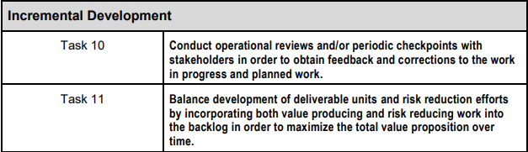
Value Driven Delivery – Sub Domain II

Slide 29
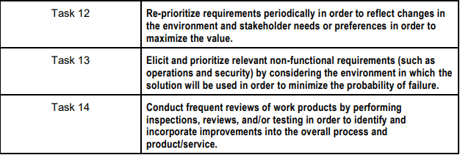
Value Driven Delivery – Sub Domain II

Slide 30
Incremental Development
Note : The tools & techniques and Knowledge & Skills are not exhaustive .
Tasks | Question | T&T | K&S
Task 10 | How to engage stakeholders to obtain feedback and correction to work in progress and planned work? | Frequent verification and Validation
Task 11 | How to maintain backlog in order to maximise total value proposition over time | Risk Adjusted Backlog | Risk Management Requirement Gathering
Task 12 | How to keep aligned with Stakeholder’s requirement considering changing environment | Review Customer Valued Prioritisation | Adaptive Planning

Slide 31
Incremental Development
Note : The tools & techniques and Knowledge & Skills are not exhaustive .
Tasks | Question | T&T | K&S
Task 13 | How to plan non functional requirement considering environment in which the solution will be used to minimise the probability of failure. | Product Roadmap Risk adjusted backlog Review Meeting
Task 14 | How to identify and incorporate improvements in to overall process and product/services | Review Meeting

